Slide 1


HTML
form element

Slide 2


Topics
Input Tag
Input Attributes
Common Input Attributes
Validations
Example for a form with multiple inputs

Slide 3

Input Tag
The <input> HTML element is one of the most important form elements which is used to accept data/input from the user.

Slide 4
Input Attributes
type
name
value
placeholder
step
autocomplete

Slide 5
Input Attributes
Boolean attributes
autofocus
multiple
readonly
disabled
novalidate

Slide 6
Common Input Types
Text
Email
Password
Number
Checkbox
Radio
Button
Color
Date
Datetime-local
File

Slide 7
Common Input Types
Hidden
Image
Month
Range
Reset
Search
Submit
Tel
Text
Time
Url
Week

Slide 8

Validations
Require
Type
Accept
Min and max
Minlength and maxlength
Size
Pattern

Slide 9
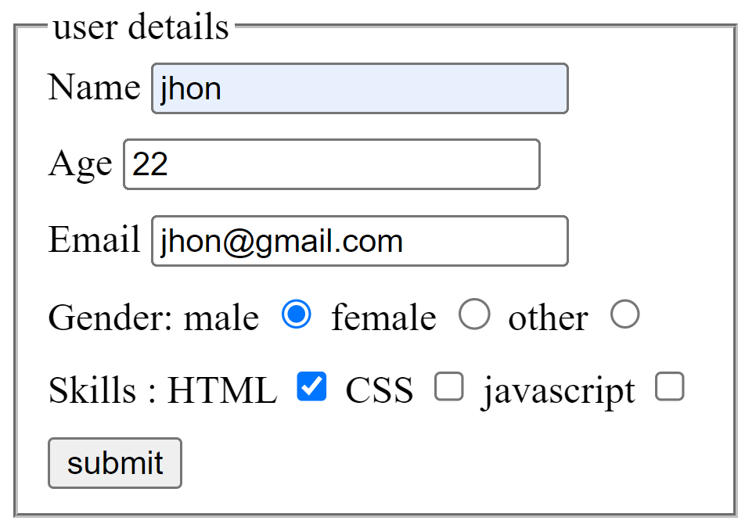
Example for a form with multiple inputs

Slide 10

THANK YOU

